Slide 1
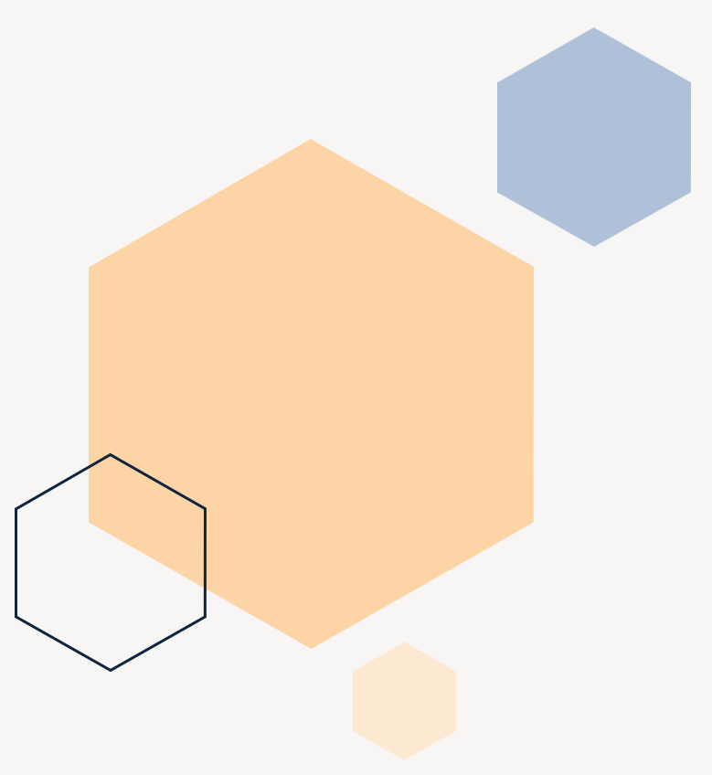
Depression detection in social networks
Martí Caixal i Joaniquet

Slide 2
Agenda
Introduction
Objectives
Methodology &
Development
Results
Conclusions

Slide 3


What problem are we facing?
Introduction
More depression messages than other types
Yet, they receive less attention
Notes:
Explain there is way more depression messages than cyberbullying.
Not only this, but those depression messages do not receive as much attention as other type of messages.
Why? Unlike bullying, they are not attacking another individual, instead they are attacking themselves. No one reports them and are more difficult to identify.

Slide 4
Objectives
NLP PROLEM
Find out which method gives the best results and how they differ
Shallow Learning:
Naïve Bayes
Decision Tree
Random Forest
SVM
KNN
Hyper Parameter Search
Deep Leaning
RNN
RNN LSTM
RNN GRU
Transformers (BERT)

Slide 5
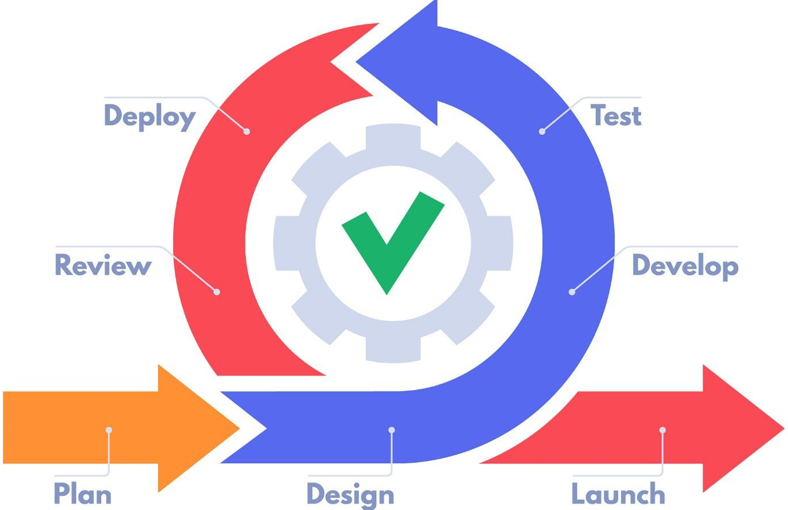
Planification
Methodology & Development
Short iterations
Friendly to changes
Independent subobjectives
Easy to detect errors
Good control of flow
Agile Methodology

Slide 6
Data used
Methodology & Development
Mental Health Twitter (Twitter 3)
Depression Twitter (Twitter Scale)
Depression Reddit (Reddit)
Only the message and label
Labeled in a scale from 1 to 5
Already cleaned
10000 messages
2 classes
Unbalanced (80/20)
“ @cosmicgirlie Thinking of you. Everything crossed Turn baby turn! “

Slide 7
Data used
Methodology & Development
Mental Health Twitter (Twitter 3)
Depression Twitter (Twitter Scale)
Depression Reddit (Reddit)
Only the message and label
Labeled in a scale from 1 to 5
Already cleaned
45000 messages
4 classes (Scale from 0 to 3
Unbalanced (40/20/30/10)
“ humm dodgers scored a hr stupid dodgers i hate them“

Slide 8
Data used
Methodology & Development
Mental Health Twitter (Twitter 3)
Depression Twitter (Twitter Scale)
Depression Reddit (Reddit)
Only the message and label
Labeled in a scale from 1 to 5
Already cleaned
40000 messages
2 classes
Unbalanced (60/40)
Already cleaned
“ i used to be highly functional before but it now i can barely function at all i take everything just…“

Slide 9

Data used
Methodology & Development
Unbalanced,
target class being minority:
Undersampling
Oversampling
Recall instead of accuracy
Macro average

Slide 10

Initial preprocessing
Methodology & Development
Specific approaches
Shallow Learning
Deep Learning
Bag of Words
Word Embedding (GloVe)
TF-IDF
Delete usernames
Delete numbers
Lemmanization
Delete punctuation
Delete Stop Words

Slide 11
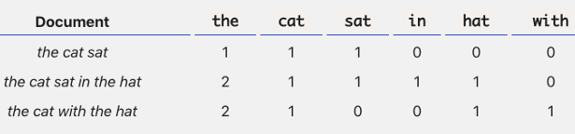
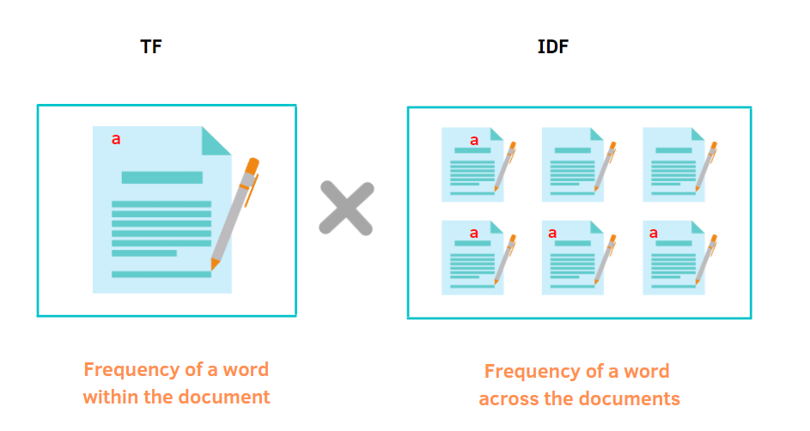
Bag of Words
Methodology & Development
TF-IDF

Slide 12

Shallow learning results
Results
Naïve Bayes
Decision Tree
Random Forest
SVM
KNN
Scikit Learn library
Default parameters
Hyperparameter Search
Notes:
While they have different results, they all have the same behaviour.
Explain difference between BOW TFIDF, number of max_features,

Slide 13
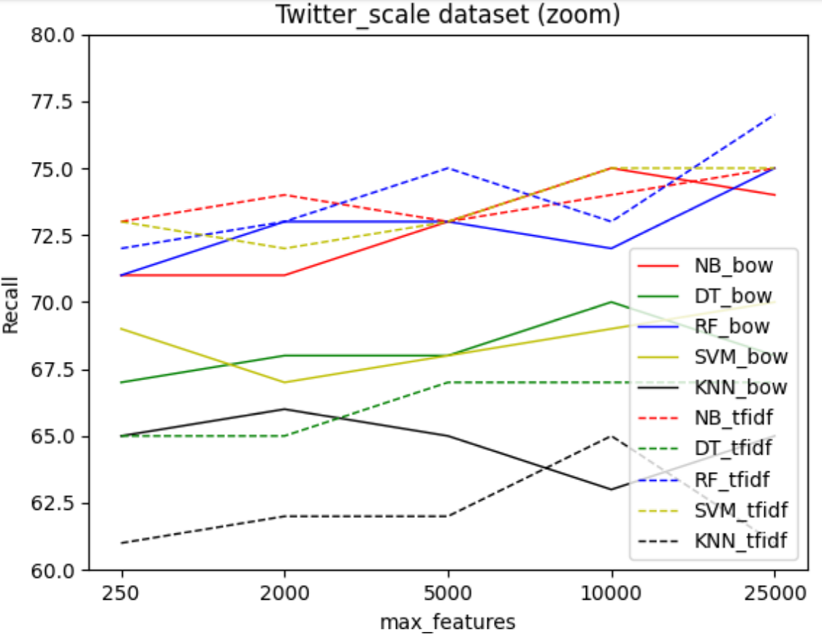
TF-IDF vs BoW & feature size
Results
TF-IDF - - - -
BoW
TF-IDF slightly better
Increase number of features slightly improves results
Notes:
While they have different results, they all have the same behaviour.
Explain difference between BOW TFIDF, number of max_features,

Slide 14
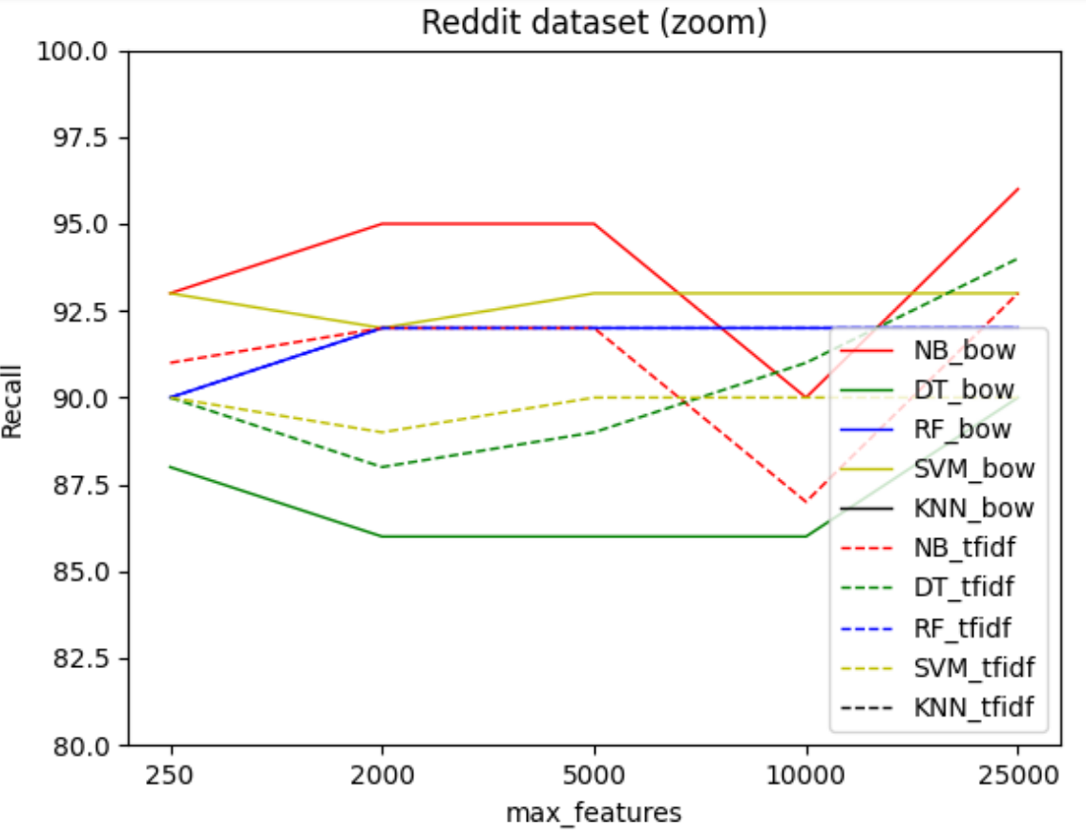
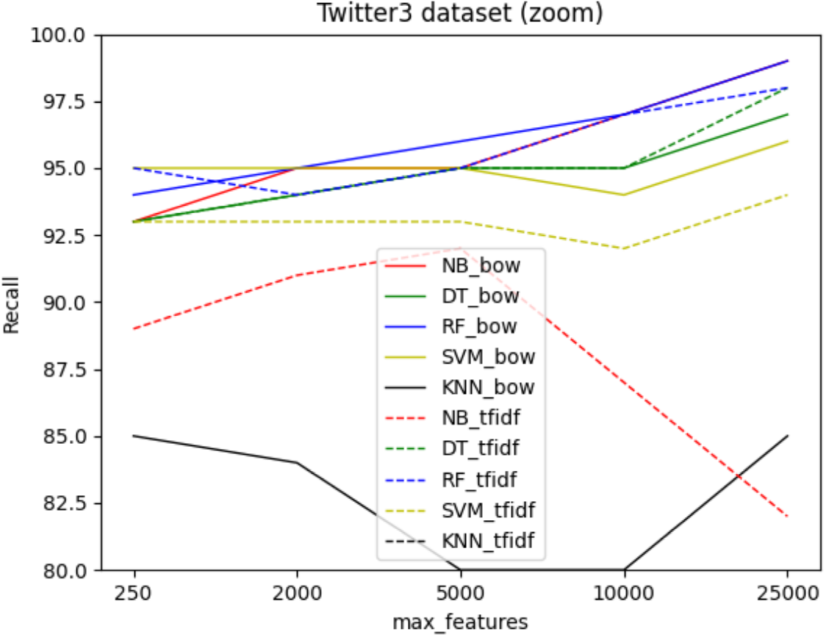
Results

Slide 15
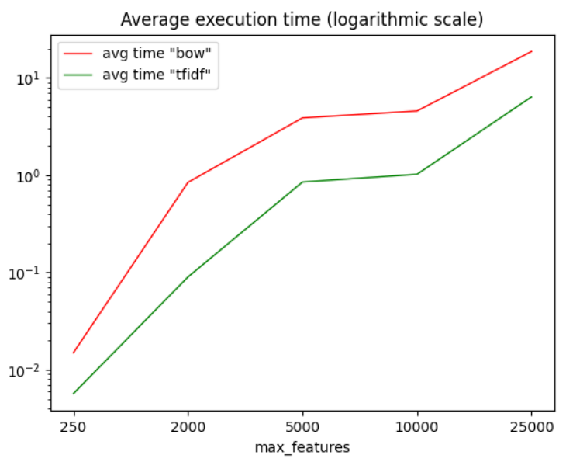
Execution time
Results
TF-IDF slightly better
nº max_features improves results
Better execution time
Notes:
While they have different results, they all have the same behaviour.
Explain difference between BOW TFIDF, number of max_features,

Slide 16
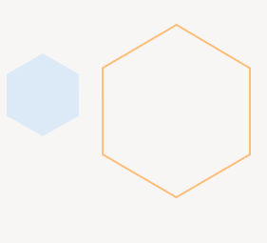
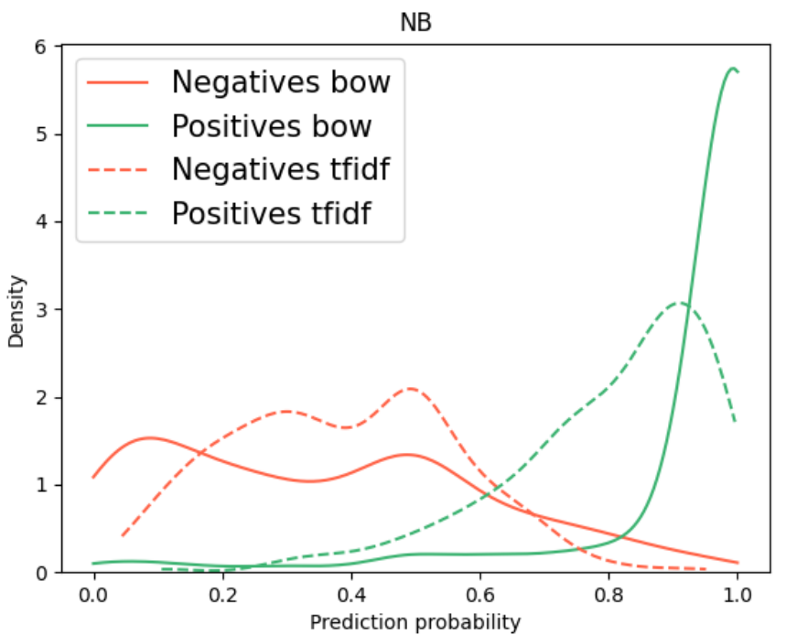
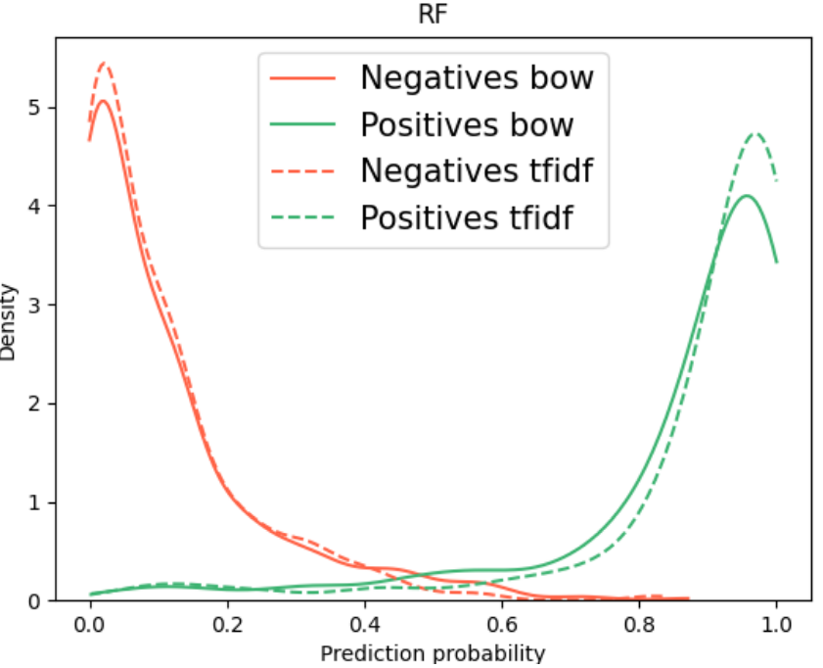
Confidence in predictions
Results

Slide 17

Hyperparameter search
Results
Model | Nº parameters | executions
SVM | 3 | 10³
KNN | 3 | 10³
DT | 4 | 8⁴
RF | 4 | 8⁴
NB | 1 | 100¹
Done with Optuna:
Python library
Optimized search
Parallelization
Results do not improve

Slide 18
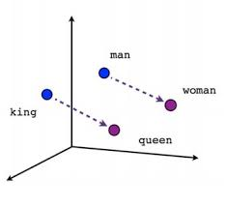
Word Vectoring
Methodology & Development

Slide 19

Deep learning results
Results
RNN
RNN GRU
RNN LSTM
BERT
Keras library
RTX 3070 Ti
Notes:
While they have different results, they all have the same behaviour.
Explain difference between BOW TFIDF, number of max_features,

Slide 20
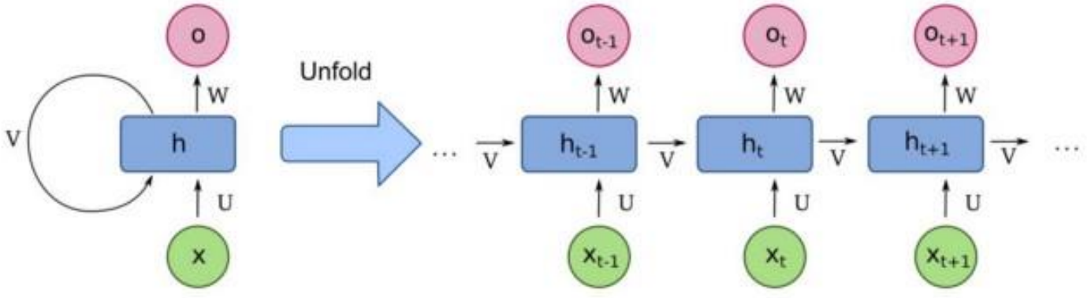
RNN
Sequence of layers
Input, activation function, output
No memory
RNN LSTM
3 gates
Memory
RNN GRU
2 gates
Memory
Simplified LSTM

Slide 21
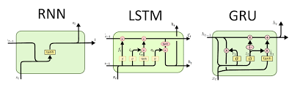
RNN
Sequence of layers
Input, activation function, output
No memory
RNN LSTM
3 gates
Memory
RNN GRU
2 gates
Memory
Simplified LSTM

Slide 22
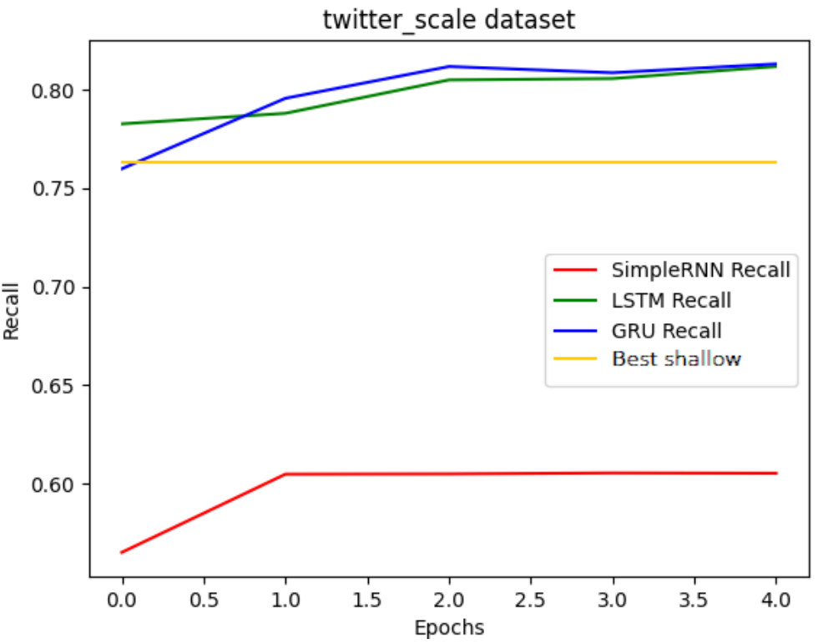
RNN
Results

Slide 23
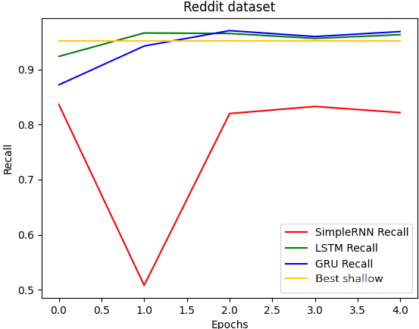
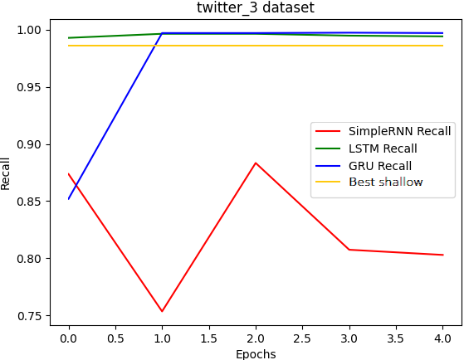
Results

Slide 24
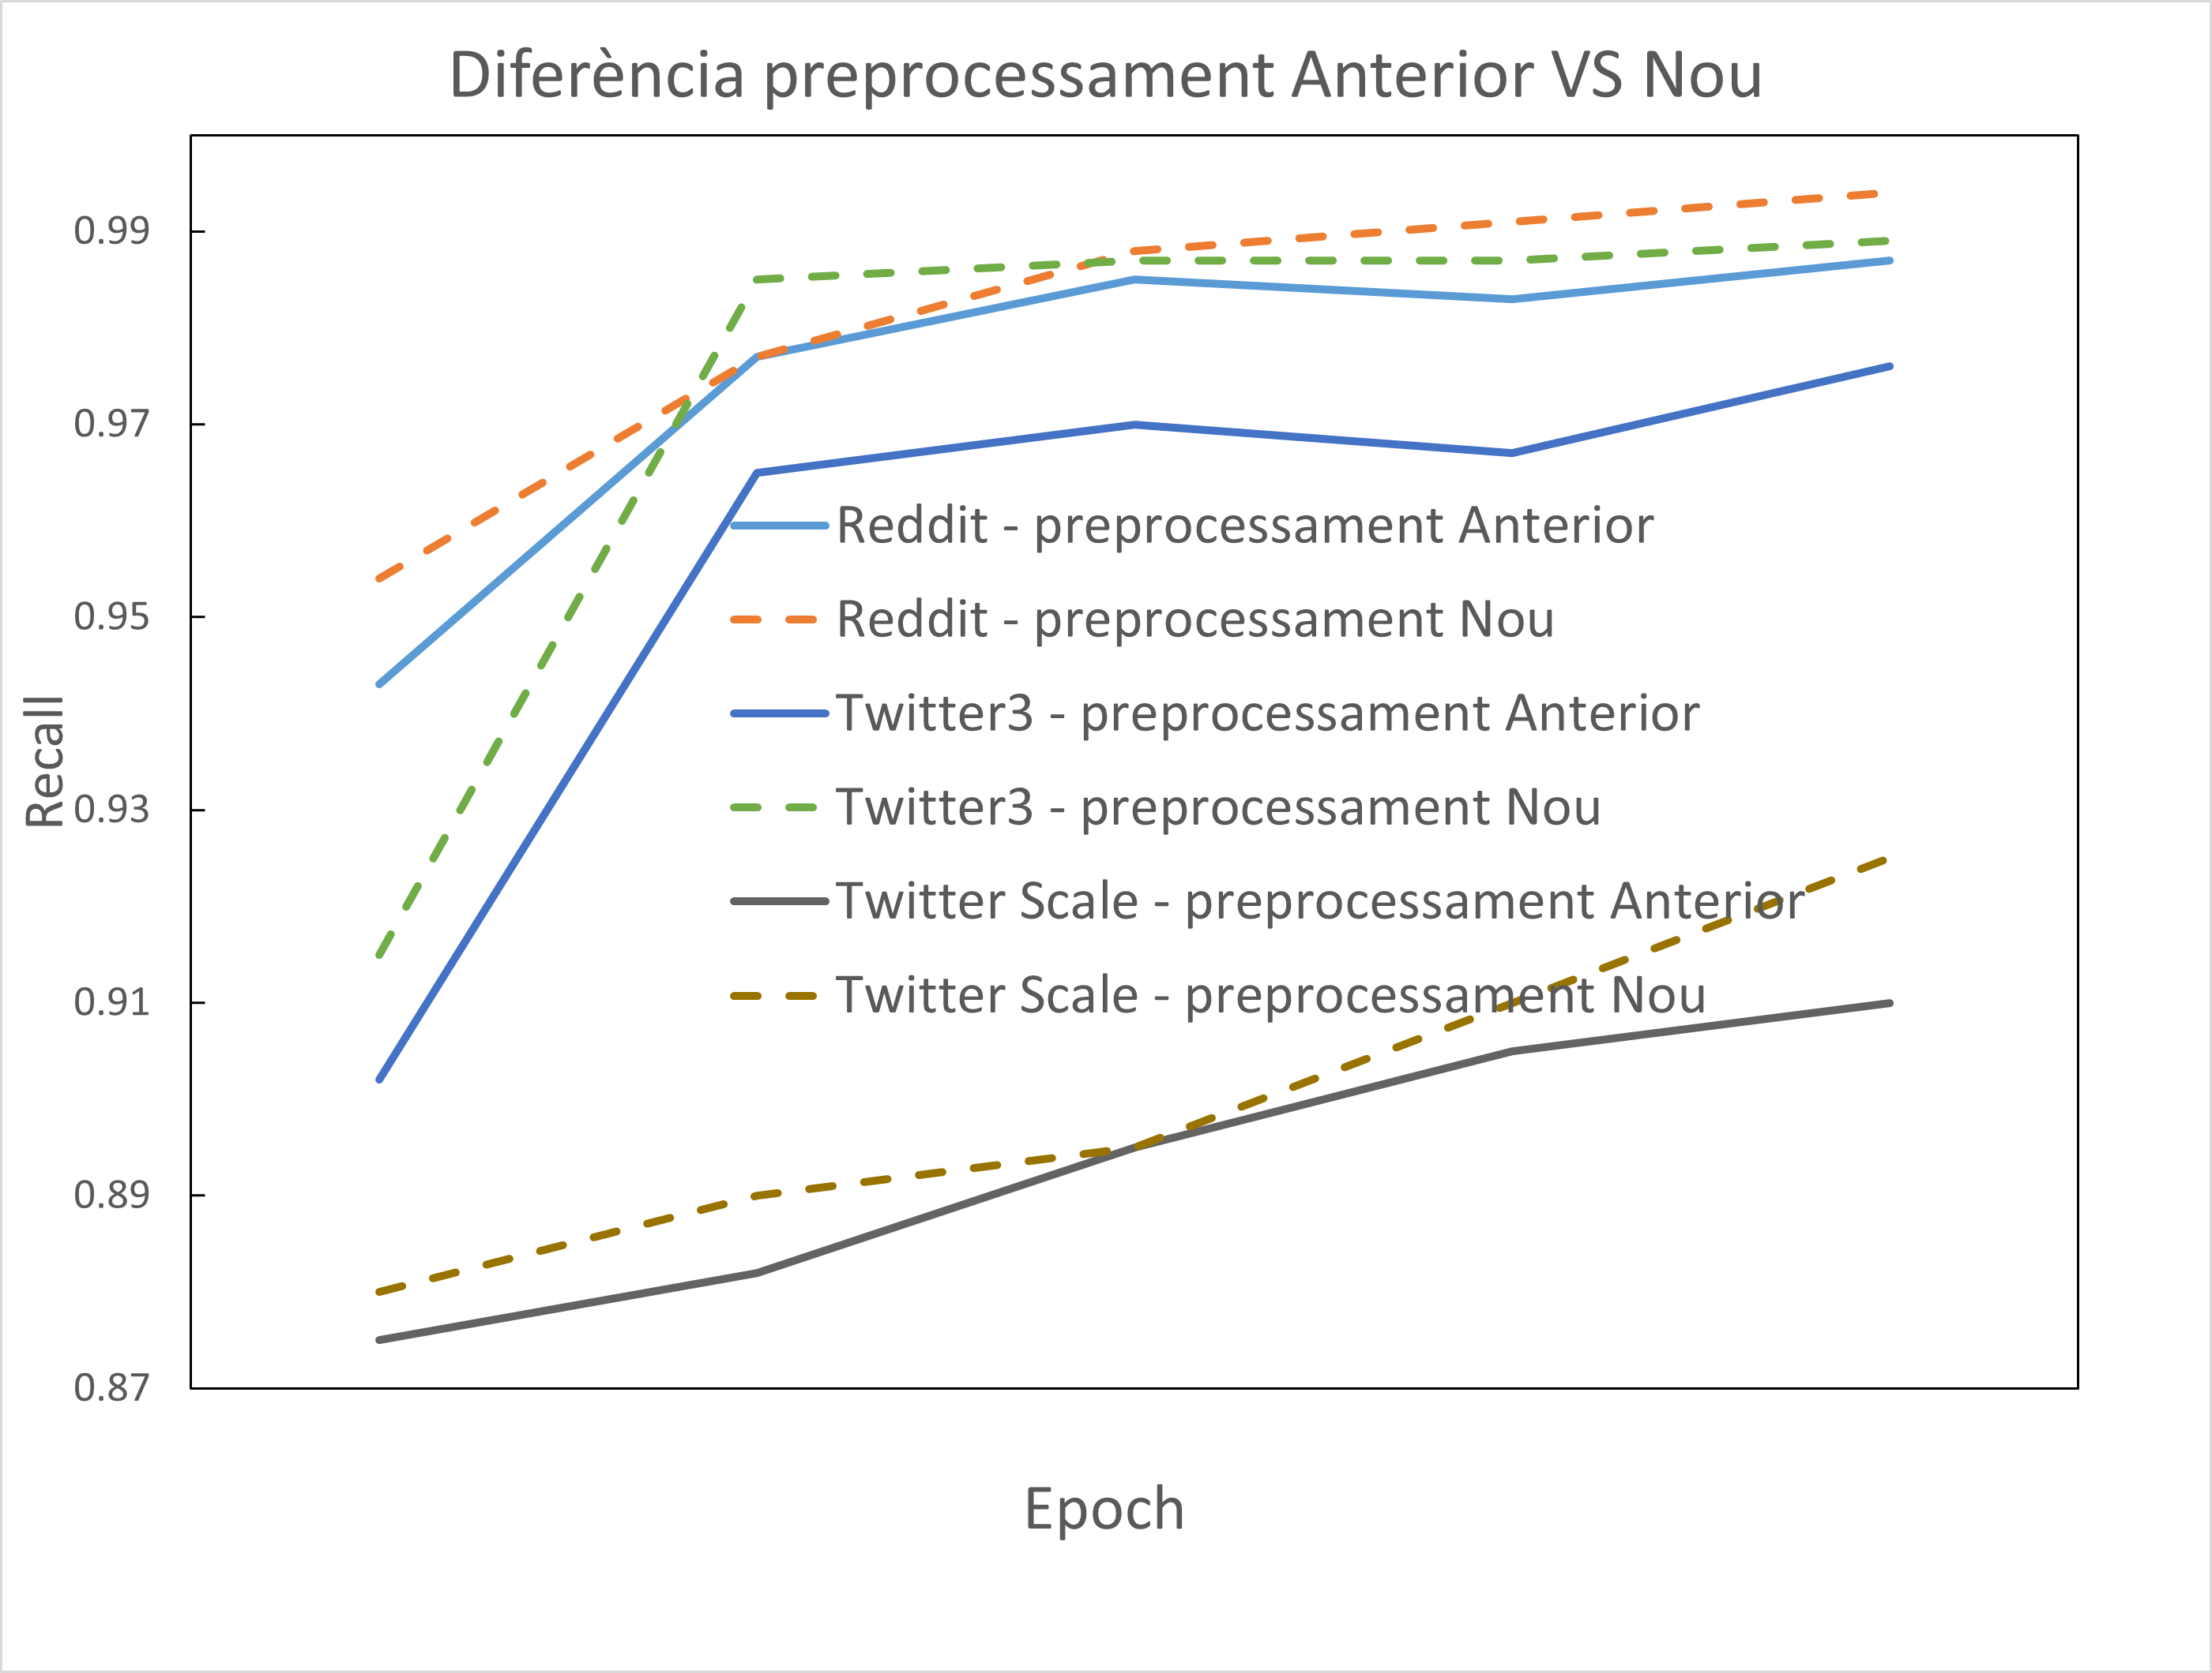
New preprocessing
Results
Delete usernames
Delete numbers
Lemmanization
Delete punctuation
Delete Stop Words

Slide 25
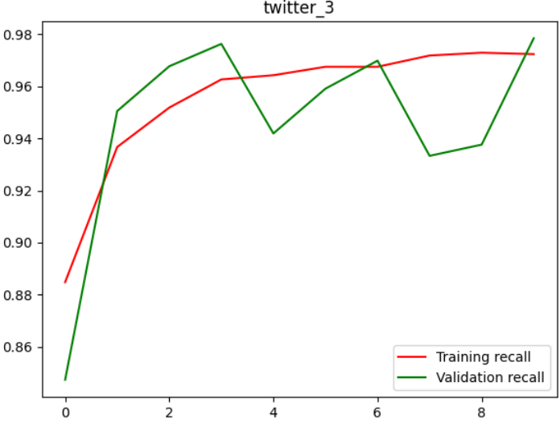
BERT (transformers)
Results

Slide 26


Differences in predictions
Results
Deep Learning Shallow Learning
“study finds no casual relationship between cannabis and depression”
“dailytonic exposure to the bacteria in soil can be good for mental hearlth and could treat depression and prevent ptsd”
“don’t be sad, armys are here for you we will always suport you btstwt be strong”

Slide 27
Conclusions
Shallow learning
Best: SVM and RF (relative to confidence)
Preprocessing highly affects on metrics
Feature extraction highly affects on execution time
Parameters are not decisive
Deep learning
Results about 10% better
Simple RNN not good at all, GRU and LSTM are needed
LSTM better than GRU with long messages
Gets the semantics instead of the relations
BERT needs more data and computing resources

Slide 28
Thank you
Martí Caixal i Joaniquet

Slide 30
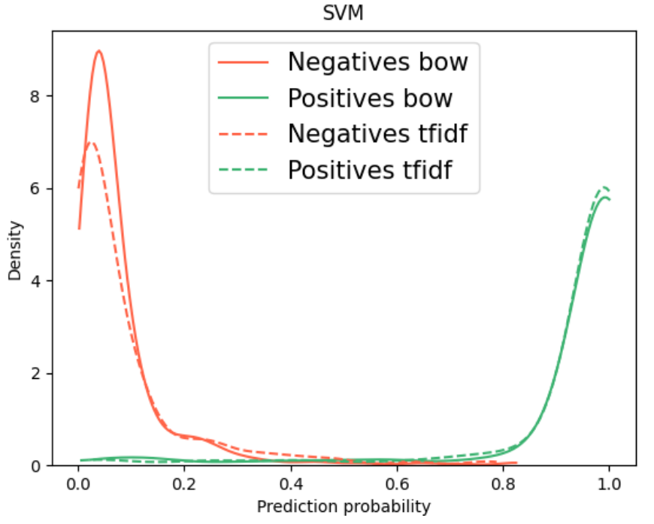
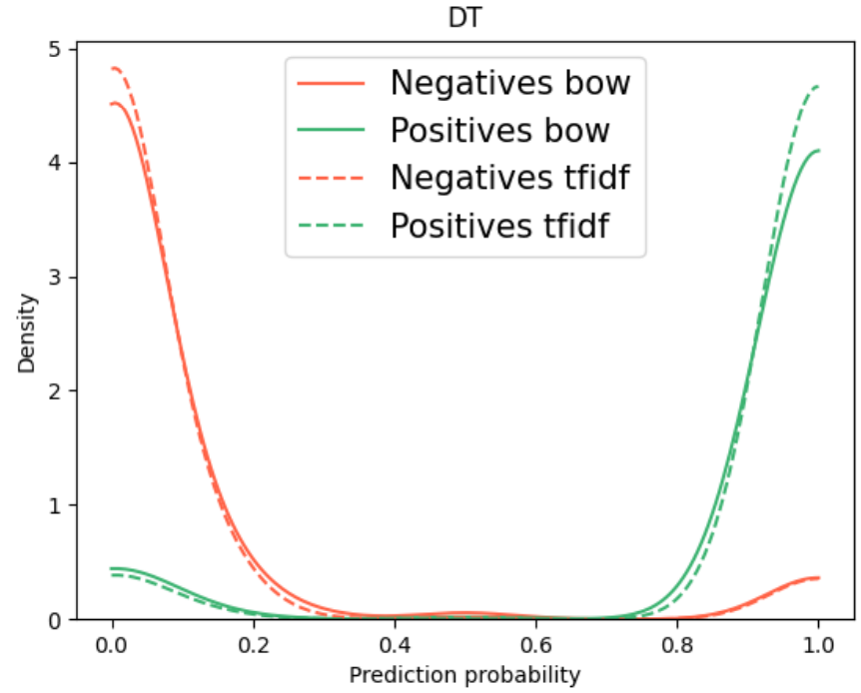

Slide 31
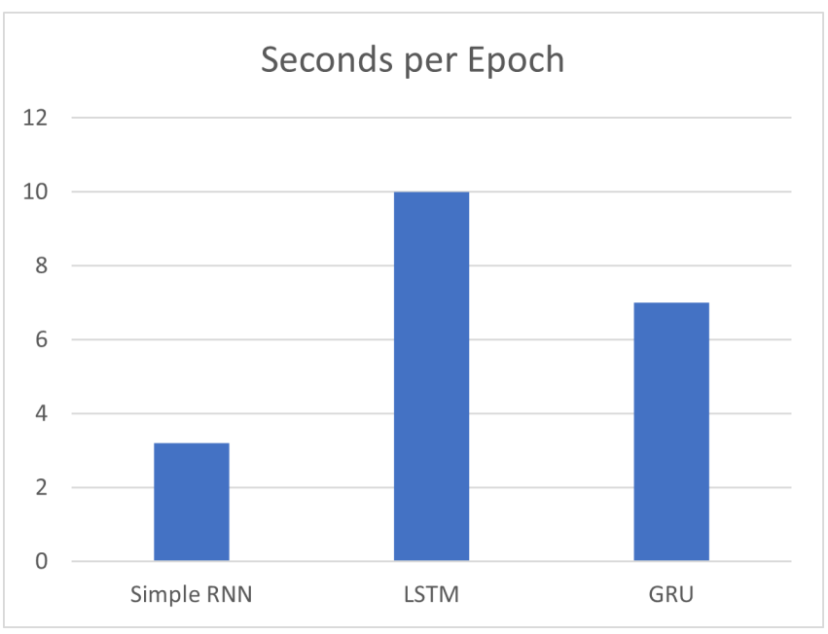
Execution time
Results

